Slide 1

P928 KICKSTARTER CROWD FUNDING
Group 4:
ANKUR KUMAR
PARIKSHIT NARAYANRAO THAKARE
AKANKSHA SUNIL MAHAJAN
YUKTA ARVIND BHAI PATEL
GAURAV GAJANAN TALELE
AVDHUT AVINASH LONE

Slide 2
INTRODUCTION
About Crowd Funding:
Crowdfunding has emerged as a powerful tool for creators, entrepreneurs, and innovators to raise funds directly from the public. Platforms like Kickstarter have enabled thousands of projects to come to life from creative endeavors to cutting-edge tech products.
Project Objective:
This project uses data analytics and business intelligence to help Kickstarter.
Overall success rate of crowdfunding projects
Countries and categories dominate the platform
Funding goals and backer engagement impact success
Most successful creators
Trends emerge over year, quarter, and month.

Slide 3
DATASET OVERVIEW
This project uses data from four connected tables:
-Projects (3,66,000 records):
-Categories (170 records):
-Creators (10000 records):
-Locations (1000 records):
* Data Cleaning & Optimization:
▪ Removed Unnecessary Columns
▪ Converted Epoch Timestamps
▪ Filtered Project States
▪ Normalized Currency

Slide 4
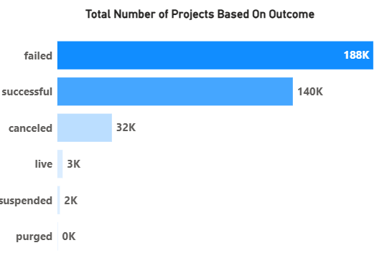
OBJECTIVE KPI’s:
Total Number of Projects based On Outcome :
▪ Less than 4 out of 10 crowdfunding projects succeed (38.35% success rate), meaning most fail.
▪ But with over 365,000 successful projects, it’s clear that success is very possible with the right approach.

Slide 5
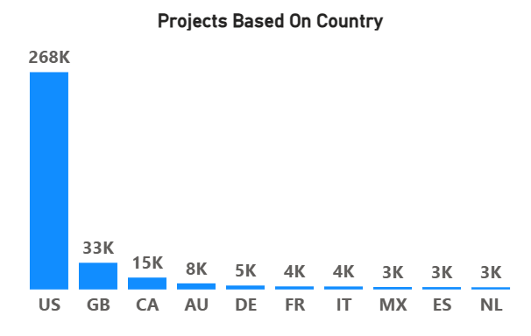
OBJECTIVE KPI’s:
Total Number of Projects based on Locations:
▪ The US leads with 268K projects, far ahead of the UK and Canada.
▪ Other countries like Australia, Germany, and France have low activity, showing crowdfunding is still US-focused — with strong potential for global growth.

Slide 6
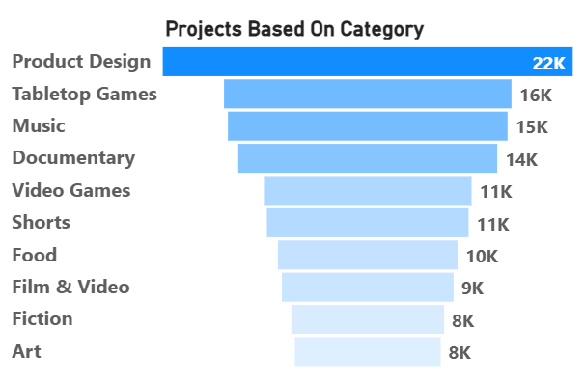
OBJECTIVE KPI’s:
Total Number of Projects based on Category:
▪ Product Design is the most popular category, followed by Games, Music, and Documentaries.
▪ Creative fields like Art and Fiction have fewer projects. The top 3 categories make up nearly half of all campaigns — showing where most activity happens.

Slide 7
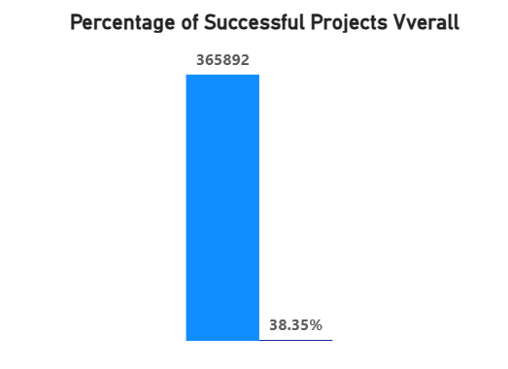
OBJECTIVE KPI’s:
Percentage of Successful Project Overall:
▪ Only 38.35% of projects succeed — most fail or get canceled, likely due to tough competition or high goals.
▪ But with 365K+ successful projects, success is still very possible.
▪ Understanding the 61.65% failures can help improve strategies and platform design.

Slide 8
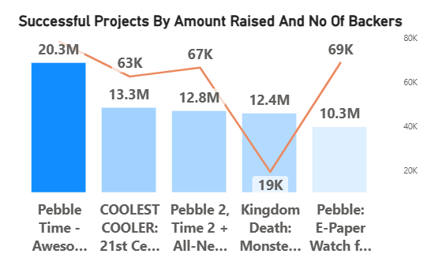
OBJECTIVE KPI’s:
Successful Projects By Amount Raised And No. Of Backers:
Some projects raised millions, but in different ways:
Pebble Time raised $20M with fewer backers.
Exploding Kittens had the most backers (219K).
Kingdom Death raised big money from a small, loyal audience.
Success isn’t about crowd size — it’s about the right audience.

Slide 9
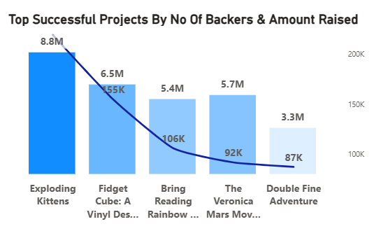
OBJECTIVE KPI’s:
Top Successful Project By No Of Backers & Amount Raised:
▪ Exploding Kittens was the top hit with $8.8M and 219K backers.
▪ Fidget Cube, Reading Rainbow, and Veronica Mars also showed strong support, driven by fan interest and unique ideas.
▪ Even smaller campaigns like Double Fine Adventure found success with loyal backers.

Slide 10
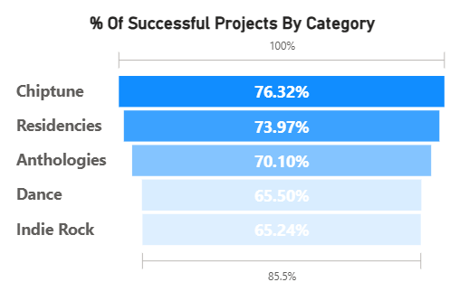
OBJECTIVE KPI’s:
Percentage Of Successful Project By Category :
▪ Chiptune, residencies, and anthologies have the highest success rates — many reach their funding goals.
▪ Dance and indie rock projects also perform well.
▪ These campaigns succeed because they have loyal communities and realistic goals.

Slide 11
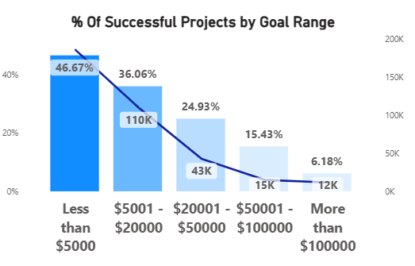
OBJECTIVE KPI’s:
Percentage Of Successful Project By Goal Range:
▪ Smaller funding goals lead to higher success rates — nearly 47% of projects under $5,000 get funded.
▪ As goals increase, success drops sharply — only 6% of projects over $100K succeed.
▪ Keep your goal low to boost your chances

Slide 12
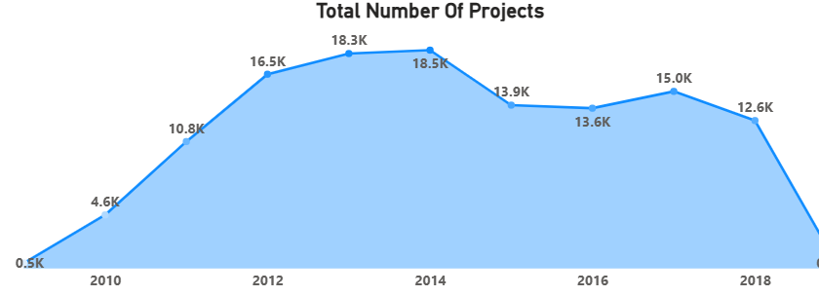
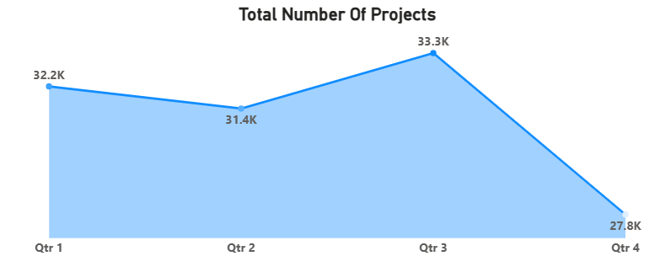
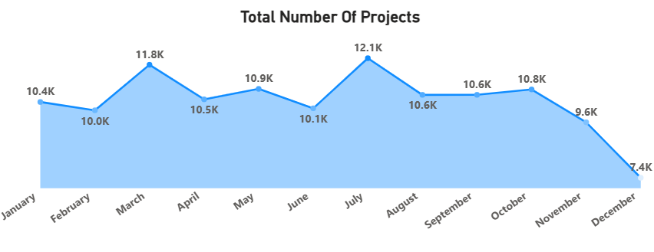
OBJECTIVE KPI’s:
Projects created By Year , Quarter, & Month:
Year-wise:
▪ Projects grew rapidly from 2009 to 2012, peaking at 16.5K.
After 2012, numbers declined, hitting a low of 0.5K by 2019.
Quarter-wise:
▪ Q3 had the highest activity (33.3K projects), while Q4 had the lowest (27.8K).
Month-wise:
▪ July was the busiest month (12.1K projects), and December had the fewest (7.4K).
Overall, activity dipped toward the end of the year.

Slide 13
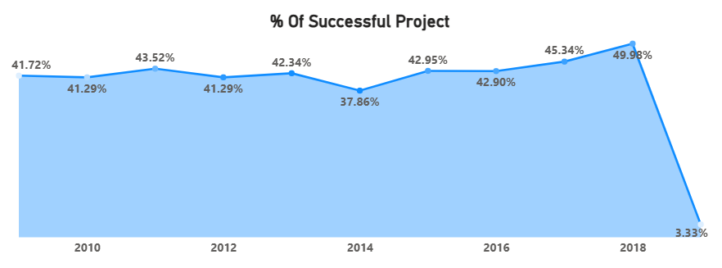
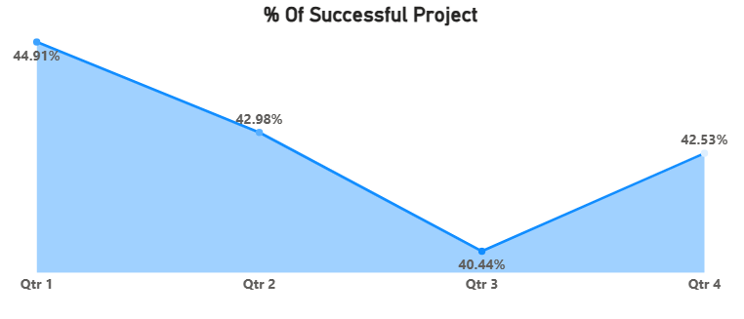
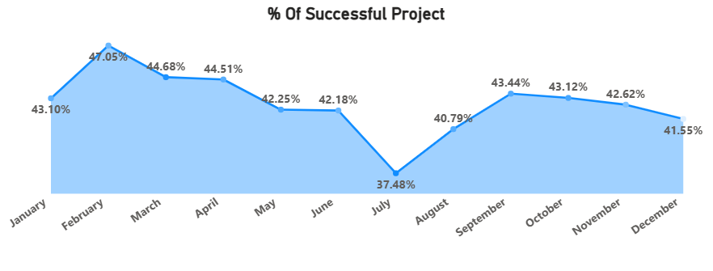
OBJECTIVE KPI’s:
Percentage Of Successful Projects By Year , Quarter, & Month:
Year-wise:
▪ Success rates stayed around 41–43% from 2009 to 2013, dropped to 37.86% in 2014, then rose steadily to a high of 49.98% in 2018.
In 2019, success rates crashed to just 3.33%.
Quarter-wise:
▪ Q1 had the highest success rate (44.91%), and Q3 the lowest (40.44%).
Q4 showed a slight recovery.
Month-wise:
▪ February had the highest success rate (47.05%), while July had the lowest (37.48%).
Rates picked up again in September before dipping toward December.

Slide 14
PROCESS
Data Collection – Used Excel and SQL to import and explore data from CSV files.
Data Cleaning – Removed empty columns, handled missing values, and converted Epoch time using Excel/SQL.
Data Transformation – Created year, month, duration, and funding-related columns using Excel/SQL.
Data Modeling – Built relationships between tables using Power BI and SQL joins.
Visualization – Used Power BI and Tableau to create dashboards and extract insights.

Slide 15
CHALLENGES & LEARNINGS
Data Cleaning : Solved using Excel and SQL to clean records and standardize values.
Understanding KPI Requirements : Team collaboration and reviewing real examples helped clarify metrics.
Understood Data modelling in more Elaborative way
We also Got to know that How we can use DAX formulae in Excel if possible, to retrieve date (min and max )
Visualizing Data Clearly : Used charts, graphs, and color-coded analysis in PowerPoint.
Time Management : Planned deadlines and tracked via shared documents.
Handling Missing Data : Used data imputation methods and filtered out outliers to maintain quality.
While Importing data Most Of Rows are Not getting Imported
While Adjusting Tableau charts.
We Also Got to Know that Creating Buckets is a new concept for us here and What is most important As Analyst

Slide 16
ANALYSIS
Most crowdfunding projects don’t succeed — only about 4 out of 10 make it. But since over 3.6 lakh projects have succeeded, it’s clear that success is possible with the right plan.
The United States is leading by a huge margin. Countries like the UK, Canada, and others are far behind, which means there’s a big chance for crowdfunding to grow worldwide.
People mostly raise money for product ideas, games, and music. These areas get the most attention.
Creative areas like art or fiction have fewer projects — maybe because they’re harder to fund.

Slide 17
ANALYSIS
If you ask for less money, you have a better chance. Projects asking for under $5,000 succeed more often.
Asking for very high amounts rarely works.
Some projects succeed with massive support (like Exploding Kittens), while others succeed with fewer but loyal supporters (like Kingdom Death). It’s not about how big your crowd is — it’s about how strong it is.
Over the years, crowdfunding grew until 2012, then dropped slowly.
2018 was the best year for success, but after that, things dipped.
Projects in February do better, while July sees a lot of projects but not many succeed.

Slide 18
RECOMMENDATIONS
Keep your funding goal low – smaller asks get funded more often.
Build a loyal audience – success depends on who supports you, not how many.
Launch early in the year – projects in Feb and Q1 perform best.
Choose the right category – categories like Product Design and Games attract more backers.
Think global – crowdfunding is big in the US, but there’s room to grow in other countries.
Focus on value – projects that connect emotionally or solve real problems do better.

Slide 19
CONCLUSION
Crowdfunding is a great way to bring ideas to life, but it’s not easy — only about 38% of projects succeed. Still, with over 3.6 lakh successful projects, it proves that success is possible with the right approach.
Projects do better when they:
▪ Set realistic goals
▪ Launch in top-performing categories like Product Design or Games
▪ Have a loyal audience
▪ Start in early months like February
Top creators and unique campaigns show that success isn’t just about going viral — it’s about knowing your audience and delivering value. Crowdfunding is full of potential if used wisely.

Slide 20
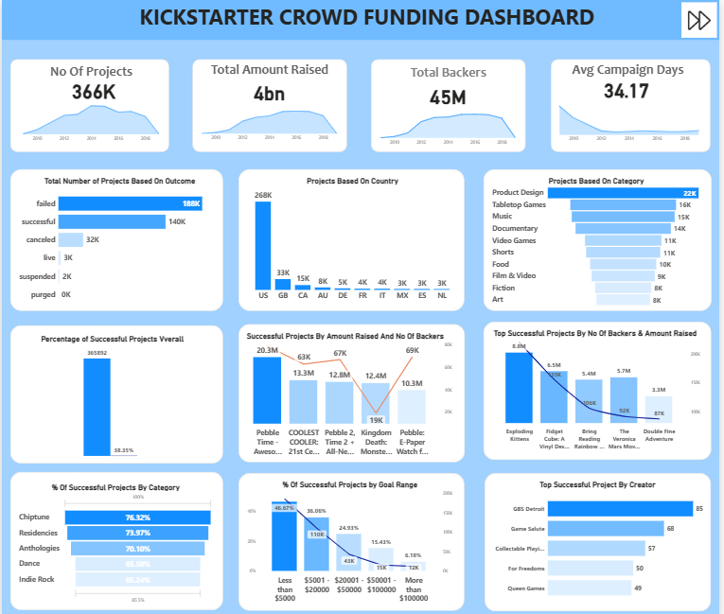
POWER BI
REPORT
1
OVERVIEW

Slide 21
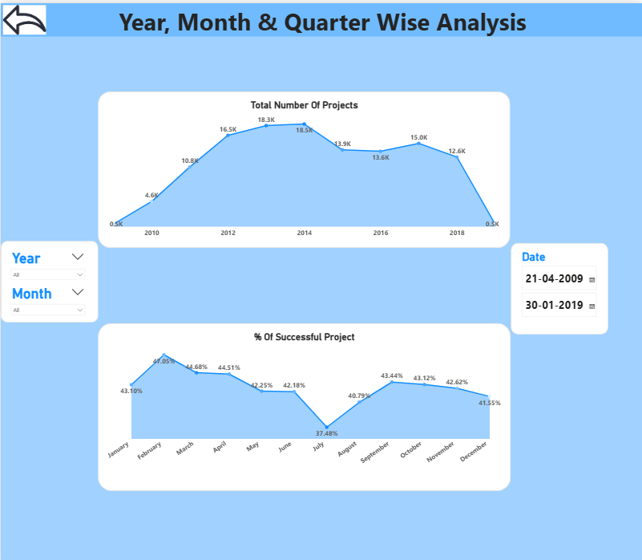
POWER BI
REPORT
2
OVERVIEW

Slide 22
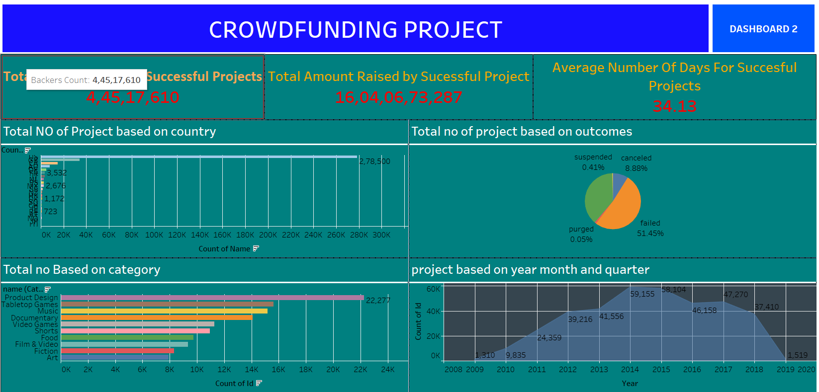
TABLEAU
REPORT
1
OVERVIEW

Slide 23
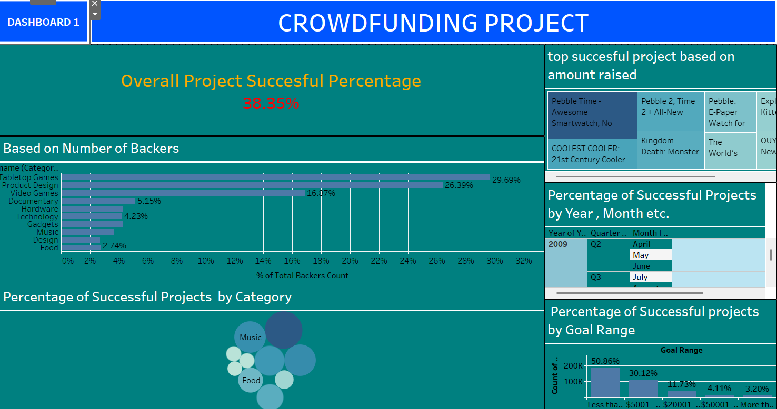
TABLEAU
REPORT
2
OVERVIEW

Slide 24
THANK YOU
We are grateful to our mentor,
Ms.NEHA TADAM

